Slide 1
Software Engineering
Lesson 2 – Requirements Management and Validation
LO2 : Carry out a requirements acquisition exercise in order to identify the main functional and non-functional requirements of a proposed software system

Slide 2
Lesson Objectives
Managing Requirements
Prioritization of Requirements using MoSCoW and Ranking
Effort Estimation of Requirements
Planning Iterations (Time-Boxing)
Requirements Validation
The 6 Principles of Requirements Validation

Slide 3
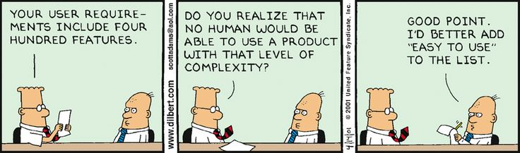
Requirements Management
As software engineers we must understand that:
Our resources are limited
We may not be able to deliver a system with all the requirements identified.
We must make the most of the time and money available to deliver the best system possible!
In order to do so, our Requirements Must be Managed Effectively through techniques such as Prioritization and Proper Iteration Planning

Slide 4
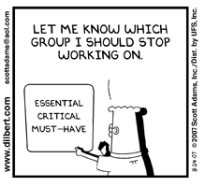
Requirements Management
Prioritization of Requirements
The process of managing the relative importance of different requirements in order to be able to implement a system with the limited resources available.
Important questions to ask when Prioritizing Requirements
Which are the core functions required from the system?
Which requirements are just ‘nice to have’ but could be put on hold?
What are the project deadlines?
What funds and resources are available ?
Are these enough to implement of all
client requirements?

Slide 5

Requirements Management
Prioritization of Requirements
Thanks to adequate prioritization we can ensure that
The most critical requirements are addressed immediately
Requirements which can be left out/implemented in future iterations are identified.
Prioritization is usually carried out with direct input from the clients / stakeholders as they are in a best position to decide what are the most urgent aspects of the required functionality.

Slide 6
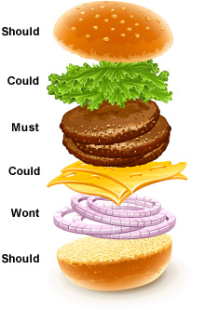
Requirements Management
Prioritization of Requirements
MoSCoW
Must Have
Mandatory requirements that are fundamental
Should Have
Important requirements that could be omitted
Could Have
Optional requirements
Want to Have
The requirements really can wait

Slide 7
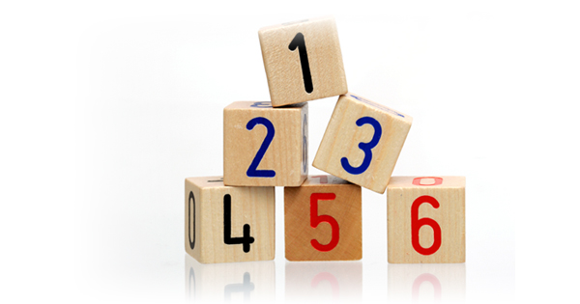
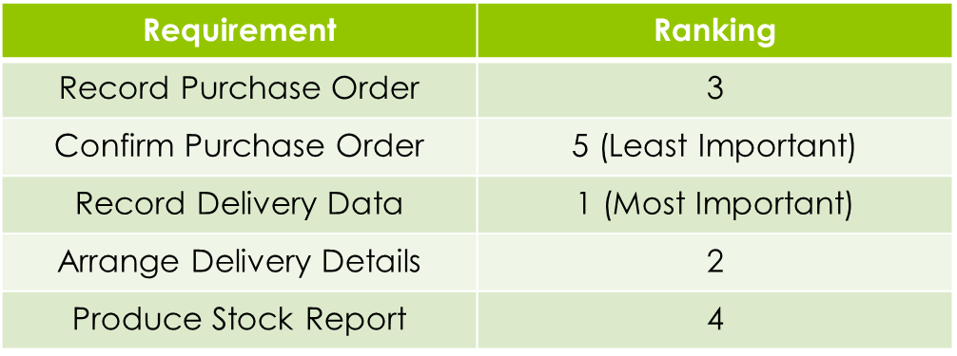
Requirements Management
Prioritization of Requirements
Ranking
Each requirement is ranked according to its relative importance.
No 2 requirements can be given the same rank!
Often used when there is only one stakeholder
Example :

Slide 8
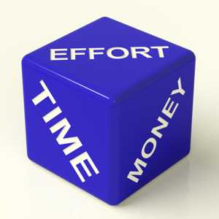
Requirements Management
Estimating Effort for User Stories
What is Effort Estimation?
The process of predicting the work required
to create software.
Why Estimate Effort?
Such predictions can give an idea of how much
functionality can be delivered by what date.

Slide 9
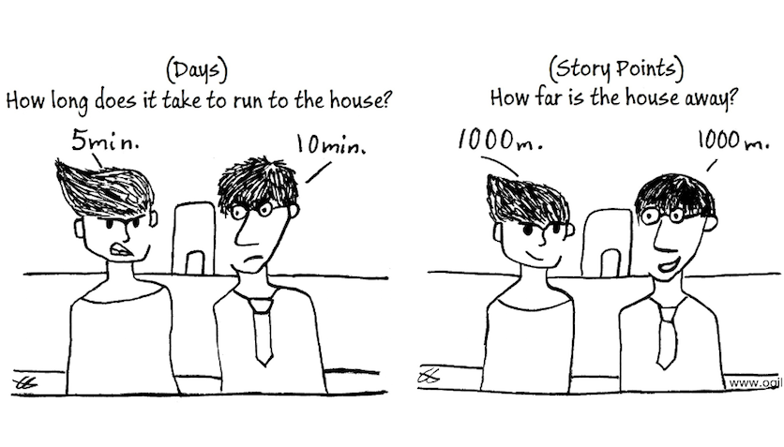
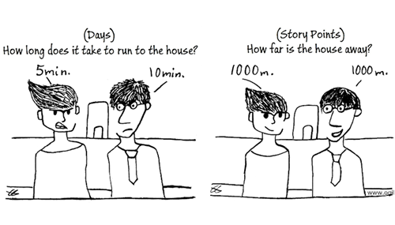
Requirements Management
Estimating Effort for User Stories
How is Effort Estimated?
Effort, is essentially the person-days (or hours) required to do something
This is known as Task Hours
However, this is not always easy to
determine or accurate!….
Why?
Different people work at different speeds!
You cannot factor for the unknown!
Committing your team to finish a set of requirements in a fixed amount of time may be dangerous!

Slide 10
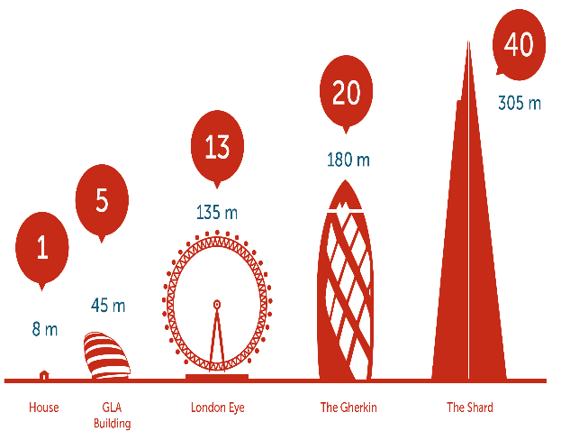
Requirements Management
Estimating Effort for User Stories
How should Effort be Estimated?
A better way of estimating the Effort required to complete a user story is to use Story Points. Rather then committing a number of hours/days to a particular user story, we commit a number of points to each Sprint!
What are Story Points?
Story Points represent the Effort involved in delivering a
Product Backlog Item. They are simply points that indicate
to the SCRUM team how difficult the story is to develop.
The higher the number of points the more difficult the
story is to develop.

Slide 11
Requirements Management
Estimating Effort for User Stories
Why Story Points?
They allow individuals with differing skill sets and speeds of working to agree on how difficult it is to develop a user story.
Example :
Two programmers might agree that a particular user story might require an Effort of 2 story points to be developed but whilst Programmer A might require 2 hours to complete a story of that effort, Programmer B might require 3hours!
Although programmers work at different speeds (or velocity), story points allow them to agree on the difficulty of the story rather than the time!

Slide 12
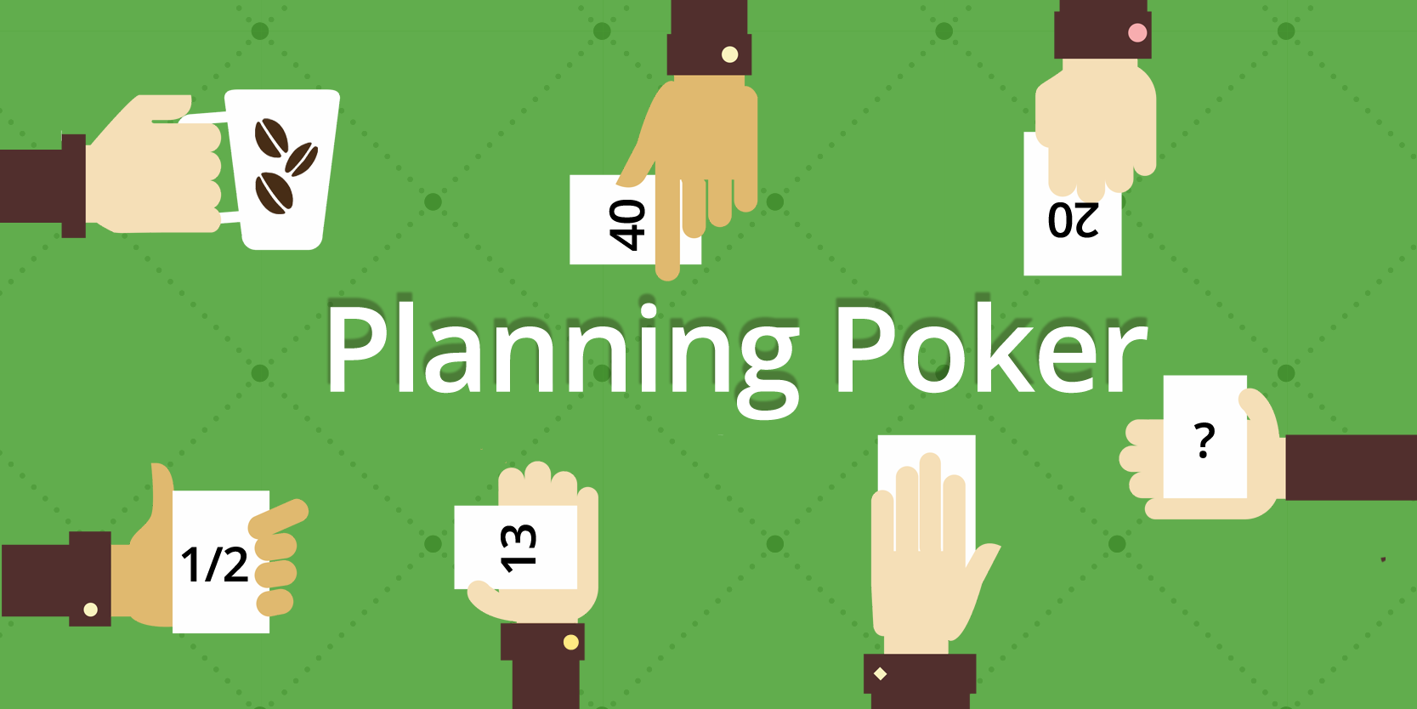
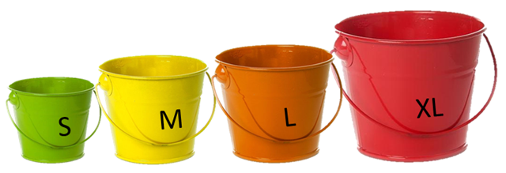
Requirements Management
Estimating Effort for User Stories
How are Story Points Assigned?
Planning Poker (or SCRUM Poker)
Relative Estimation
Bucket Backlog

Slide 13
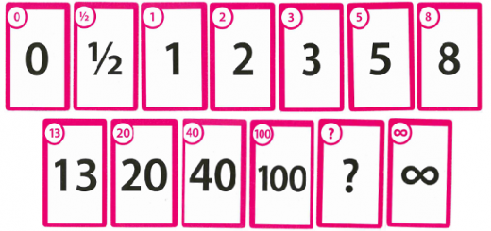
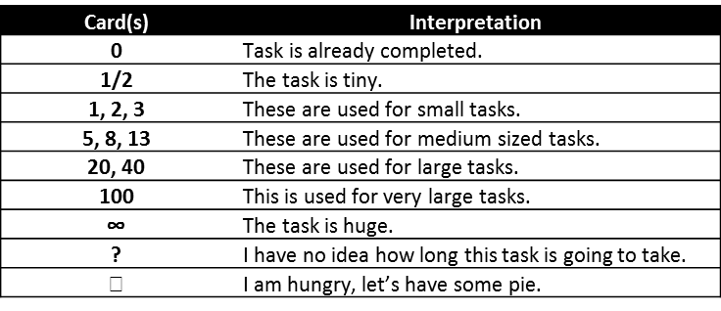
Requirements Management
Estimating Effort using Planning Poker
Each estimator holds a deck of Planning Poker cards.
The values represent the number of story points, ideal days, or other units in which the team estimates.
Estimators discuss the feature
and privately select a card to represent their own estimate of the story.
All Estimates are revealed at the same time

Slide 14
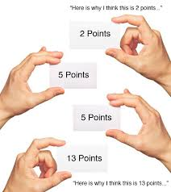
Requirements Management
Estimating Effort using Planning Poker
If all estimators selected the same value, that becomes the estimate.
If not, the estimators discuss their estimates.
The high and low estimators should especially share their reasons.
The poker planning process is repeated until consensus is achieved.

Slide 15

Requirements Management
Estimating Effort using Relative Estimation
Estimators establish a baseline to be a able to categorize user stories
They agree on a point system:
1 points = Small task
3 points = Medium task
5 points = Large task
8 points = Extra Large task
They agree on 1 user story for each size and use these user stories to compare the effort required for other user stories.
Example
If we all agreed that user story 1 is a small task worth of 1 story point and user story 2 is a medium sized task worth 3 points, if I think that user story 3 is slightly harder then user story 1 but not as complex as user story 2, then it is worth, in my opinion, 2 story points!

Slide 16
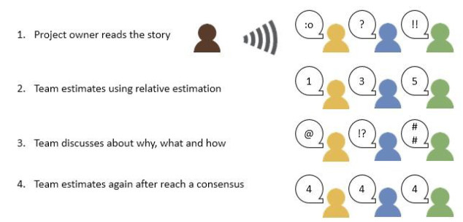
Requirements Management
Estimating Effort using Relative Estimation

Slide 17

Requirements Management
Planning Iterations through Time-Boxing
What is A Time –Box?
A previously agreed period of time during which
a person or a team works steadily towards completion
of a goal i.e. towards the completion of a system/set of requirements.
In Agile Development, an Iteration/Sprint is assigned a fixed start date and a fixed end date, in between these dates an agreed subset of the requirements/user stories identified for the system has to be developed.
The agreed subset of user stories to be completed in each Sprint should depend on the number of story points the team is capable of delivering in a given time i.e. the team’s velocity.

Slide 18
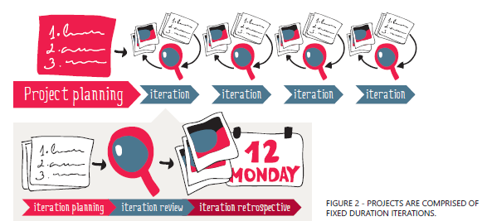
Requirements Management
Planning Iterations through Time-Boxing
The Process….
The duration of the time-box is decided. This is usually only a few weeks.
At the start of the time-box planning takes place to allow:
Stakeholders to decide what features to include in the time-box
Developers to estimate the effort of the selected features
If the developers estimate that more effort is required to complete the selected features than what the time-box allows, the least important ones are taken out.

Slide 19

Requirements Management
Planning Iterations through Time-Boxing
The Process….
Developers start working on the selected features for the time-box, at the end of the time-box they stop to evaluate their work with their clients.
Based on their client’s feedback, they plan the next time-box.
The process repeats itself until all requirements have been completed or until time/money run out.

Slide 20
Requirements Management
Planning Iterations through Time-Boxing
An Example….assume the team’s velocity is 1 story point per day…
The Product Backlog
User Stories | Priority | Effort
As a user, I can create a game character by selecting a predefined avatar and specifying the character name | Must | 3
As a user, I can manage the weaponry inventory for my character by adding new weapons to the inventory, deleting weapons from the inventory and equipping my character with selected weapons | Could | 5
As a user, I can save my game’s progress at any time during game play | Should | 3
As a user, I can battle other characters during game play to earn points and new weapons | Must | 10
As a user, I can fully customize my character avatar by selecting different physical and facial features. | Would | 15

Slide 21
Requirements Management
Planning Iterations through Time-Boxing
An Example….
Time-Box 1
Time-Box 1 From : 1/11/2015 To: 16/11/2015 | Duration : 16days
User Stories | Priority | Effort
As a user, I can create a game character by selecting a predefined avatar and specifying the character name | Must | 3
As a user, I can save my game’s progress at any time during game play | Should | 3
As a user, I can battle other characters during game play to earn points and new weapons | Must | 10

Slide 22
Requirements Management
Planning Iterations through Time-Boxing
An Example….
Time-Box 2
Time-Box 2 From : 20/11/2015 To: 10/12/2015 | Duration : 20days
User Stories | Priority | Effort
As a user, I can manage the weaponry inventory for my character by adding new weapons to the inventory, deleting weapons from the inventory and equipping my character with selected weapons | Could | 5
As a user, I can fully customize my character avatar by selecting different physical and facial features. | Would | 15

Slide 23
Requirements Management
Planning Iterations through Time-Boxing
In Agile Development, Time-Boxing allows
The development team to focus on the most important things first so that they are finished before the end date for the iteration.
Evaluate what has been accomplished at specific intervals of the project life cycle.
Reduce Risk thanks to short feedback loops between clients and developers.
The critical rule of time- boxed work is that work should stop at the end of the time-box, and review progress.
Time-boxed iterations are a distinctive feature of Agile approaches
such as Scrum and Extreme Programming.

Slide 24

Requirements Validation
In addition to checking whether “the requirements have been specified correctly”,
it is also important to check whether “the correct requirements have been specified”.
We need to Verify and Validate our Requirements
The six principles of requirements validation :
Involvement of the correct stakeholders
Separating the identification from the correction of errors
Validate requirements from different viewpoints
Adequate change of documentation type (vary between text, diagrams, etc.)
Construction of development artifacts (e.g. create test cases before development)
Repeated validation

Slide 25
End of Lesson 2
Any questions?

